Slide 1
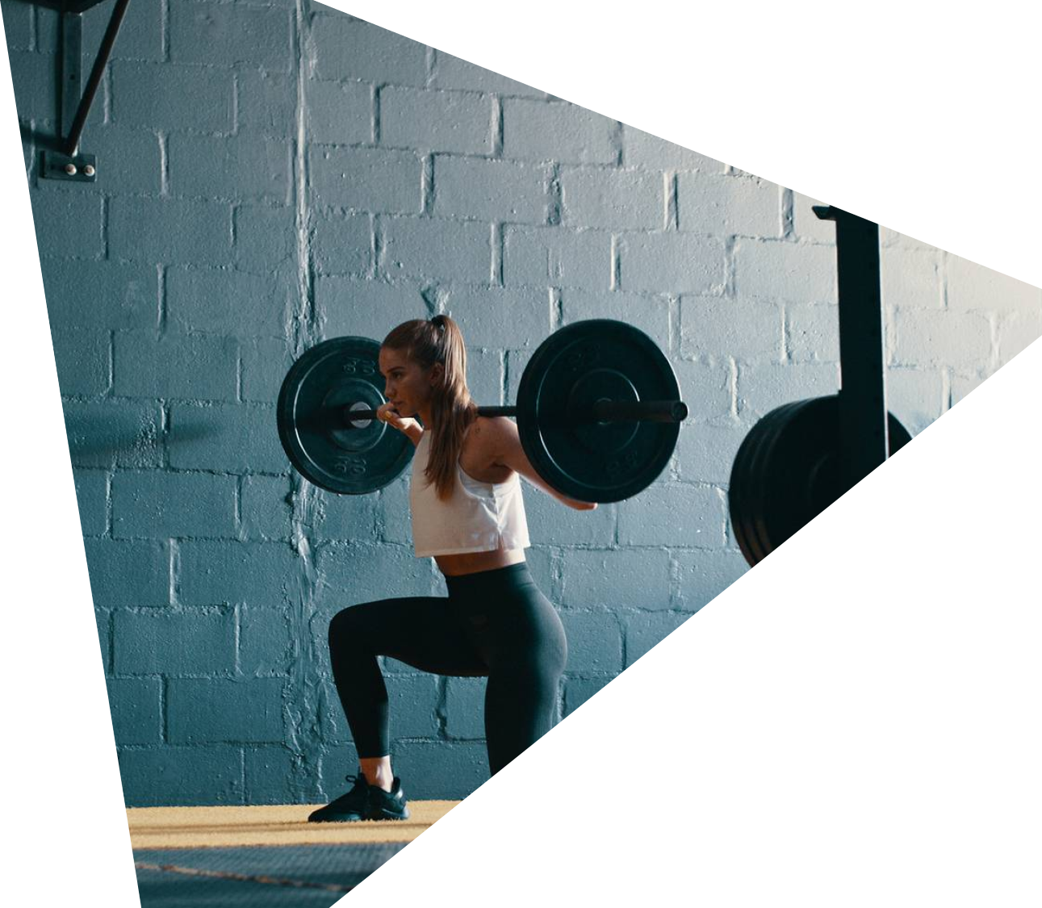
YOUR FITNESS JOURNEY BEGINS TODAY
FITNESS
FITNESS
FITNESS
FITNESS
FITNESS
FITNESS
FITNESS
WITH ASANa ai

Slide 2
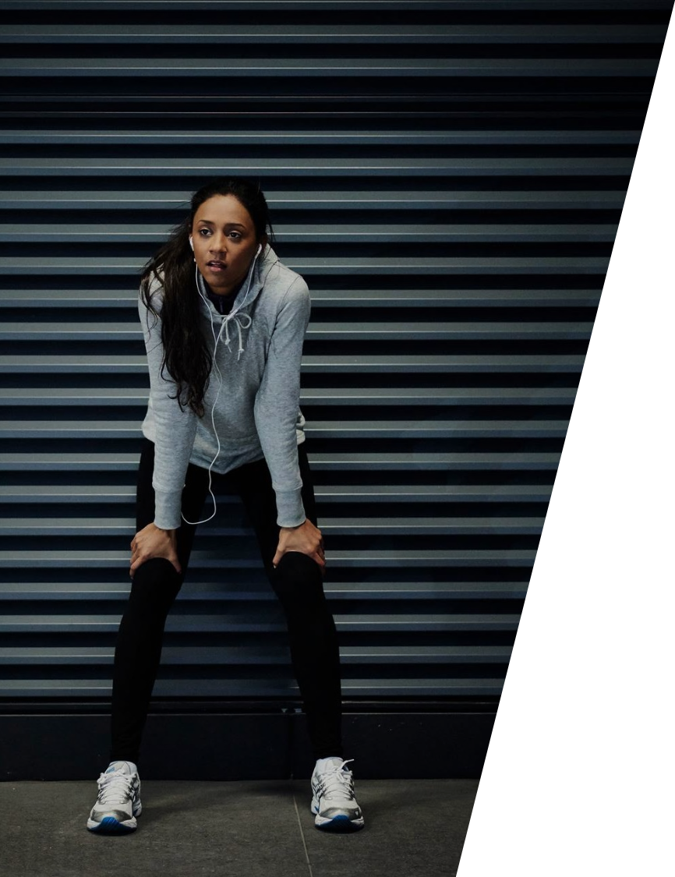
AGENDA
INTRODUCTION
Module list
Module Explanation
Thanks
AGENDA
AGENDA

Slide 3
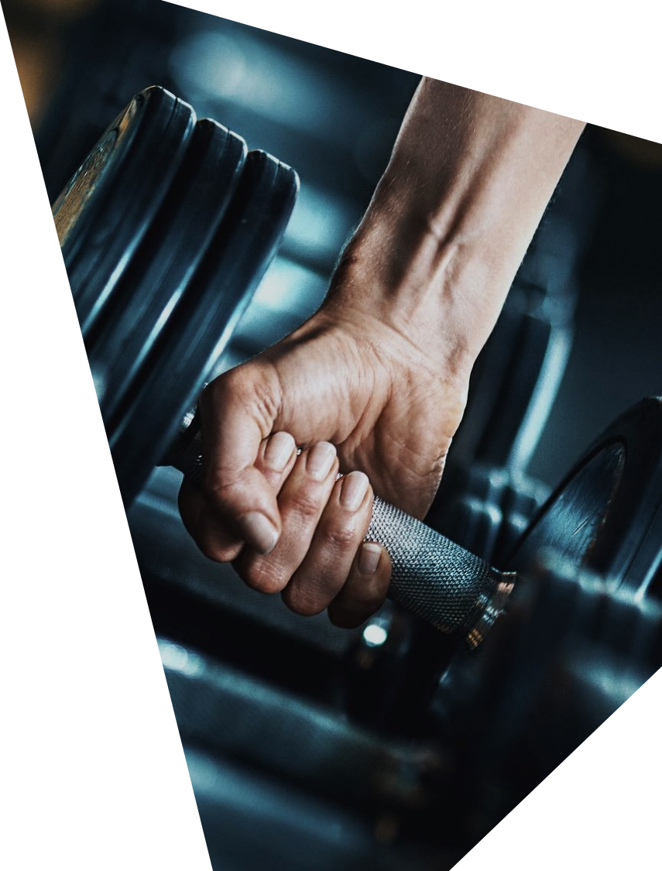
INTRODUCTION
INTRODUCTION
INTRODUCTION
AsanaAi is not just another fitness app, it's a comprehensive tool designed to cater to various aspects of holistic health, ranging from yoga practice to cardiovascular workouts, and even mental well-being.

Slide 4
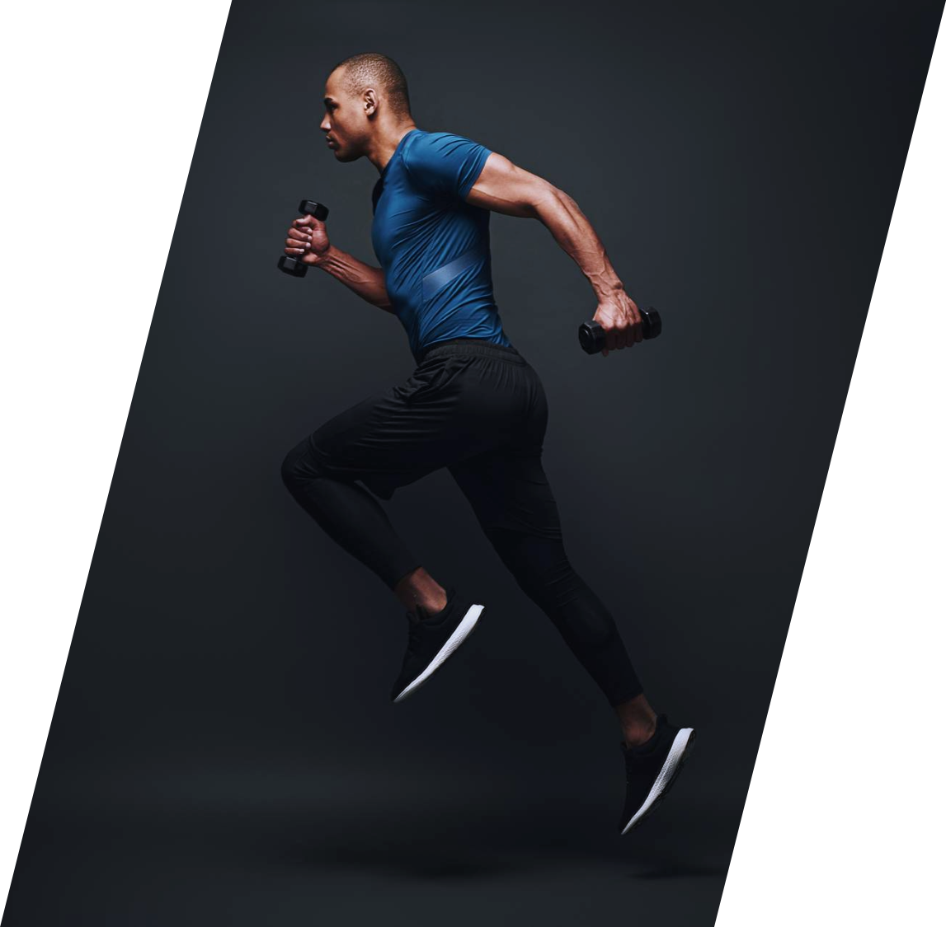
WHY CHOOSE ASAna ai
PERSONAL
TRAINING
PERSONAL
TRAINING
PERSONAL
TRAINING
PERSONAL
It is a one stop solution for overall fitness.
User-friendly, interactive ui motivates user to improve fitness

Slide 5
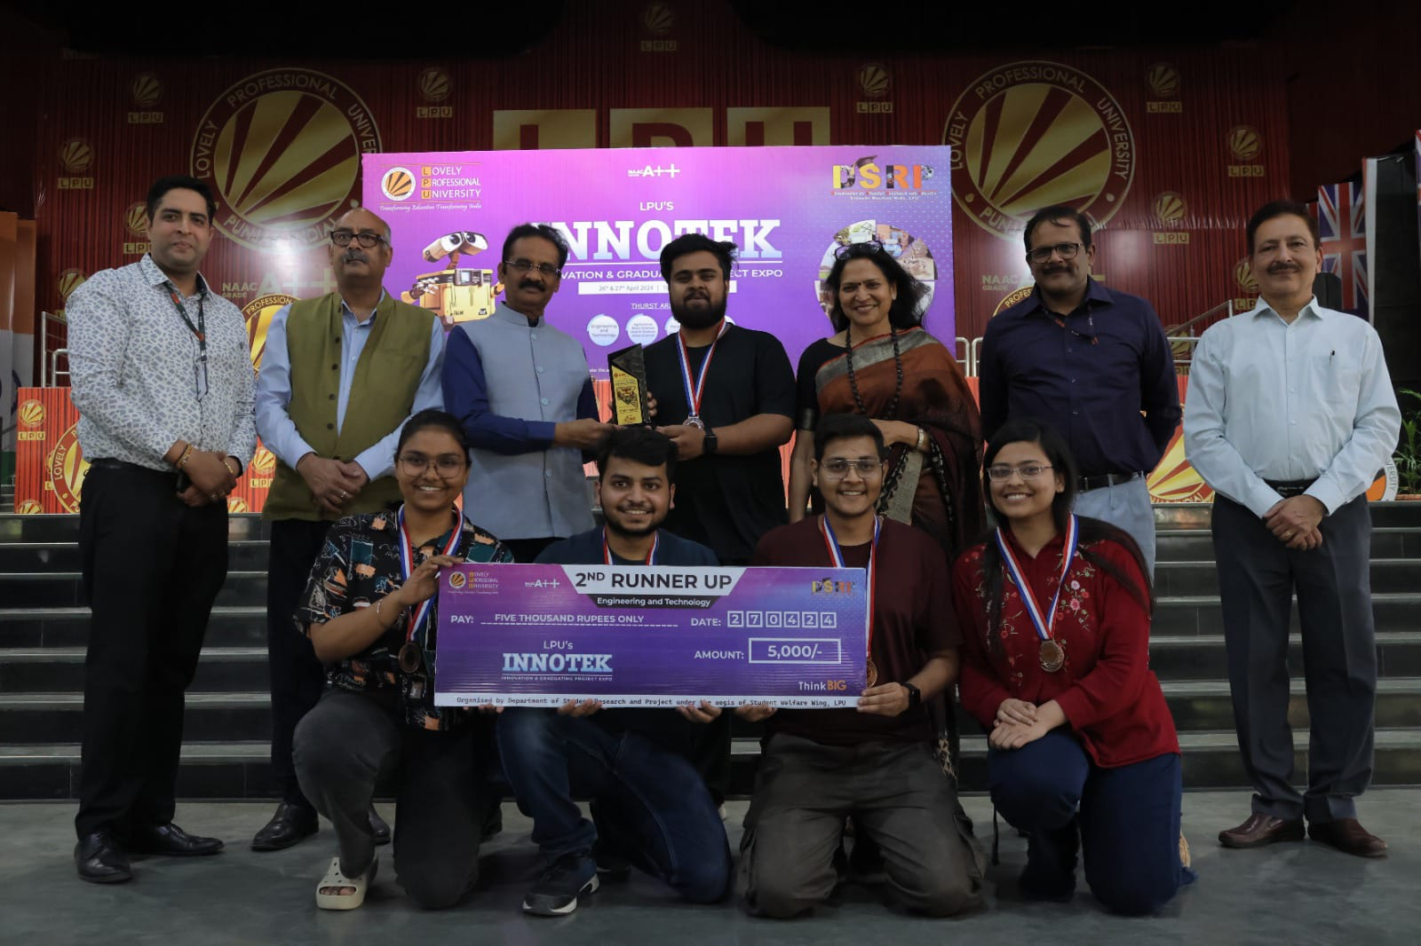
INNOTEk 2024
2nd runner up (engg.)

Slide 6
PRESENTED AT THE NATIONAL BOARD OF ACCREDITATION
achievementS

Slide 7

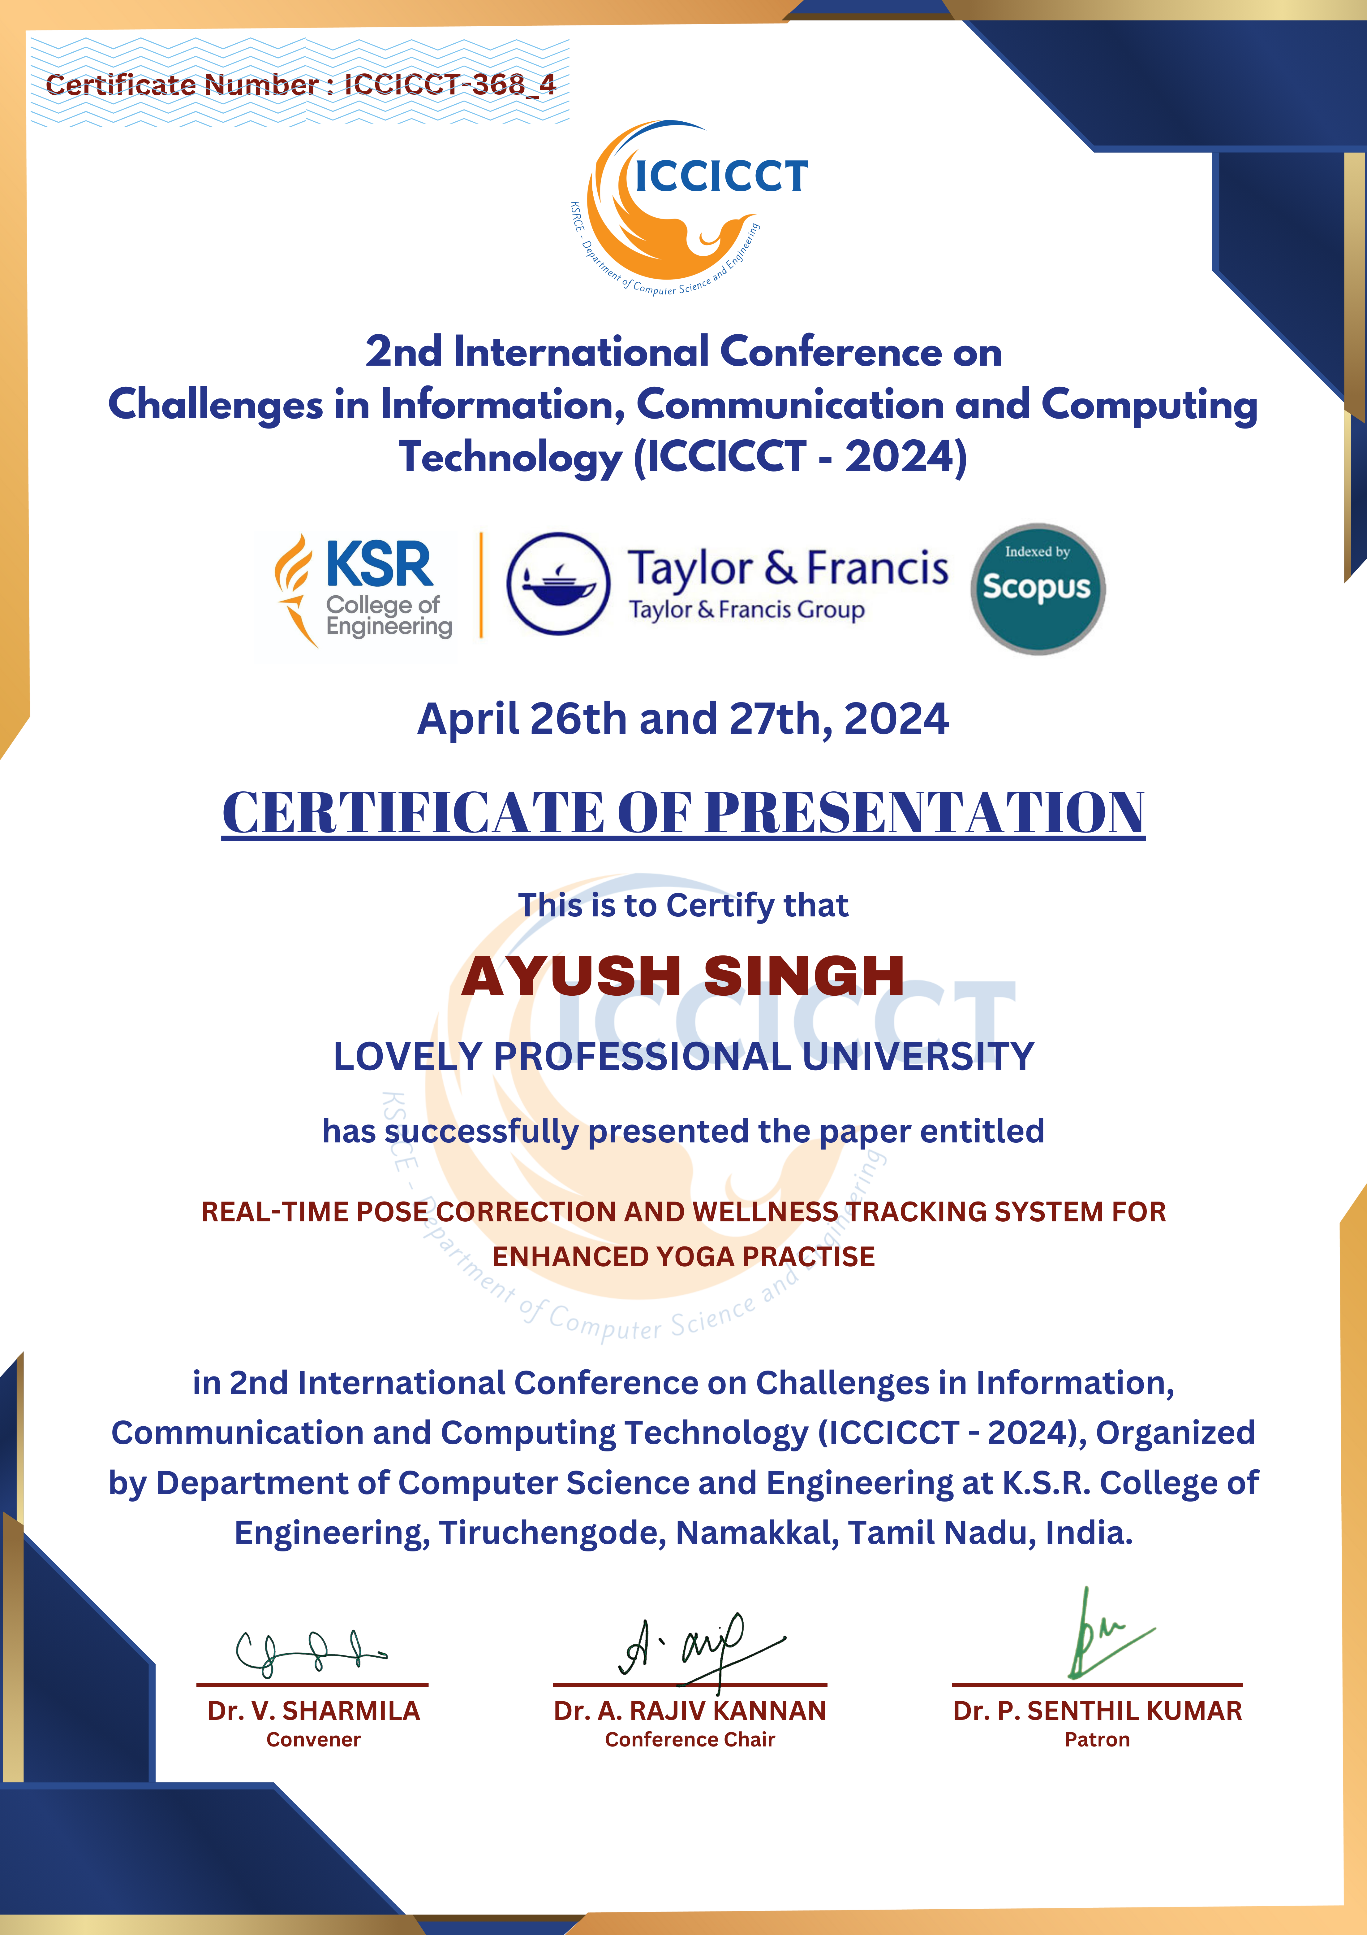
Presented for research paper acceptance at taylor & francis (scopus indexed)
At ksr College of engineering
achievementS

Slide 8

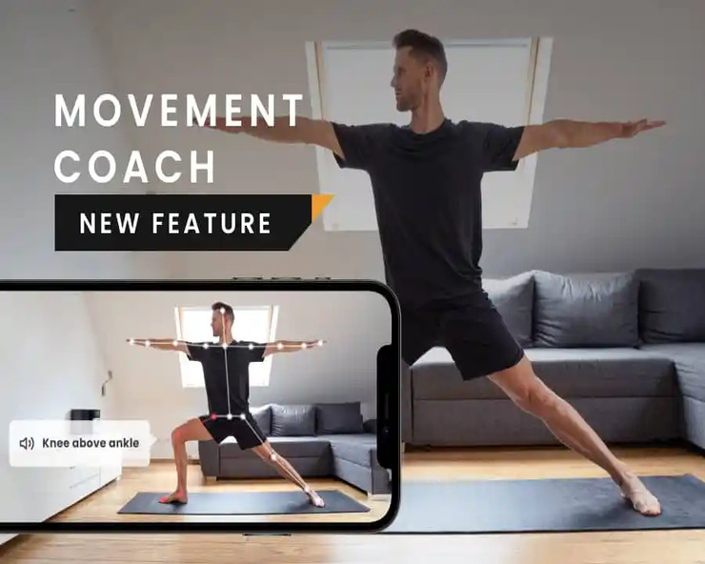
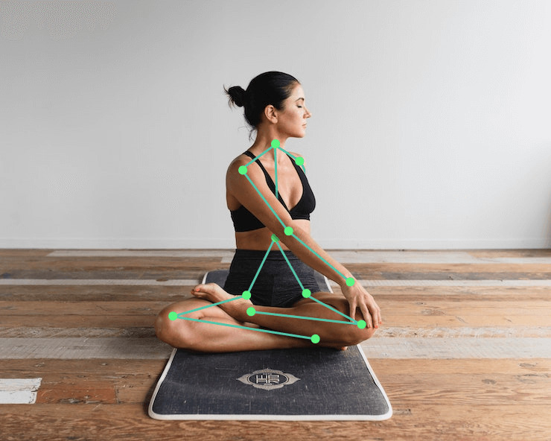
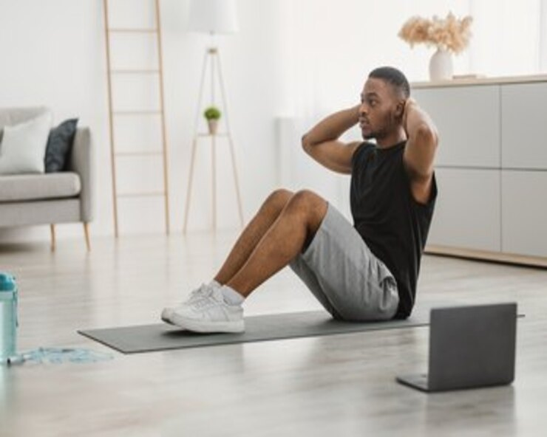
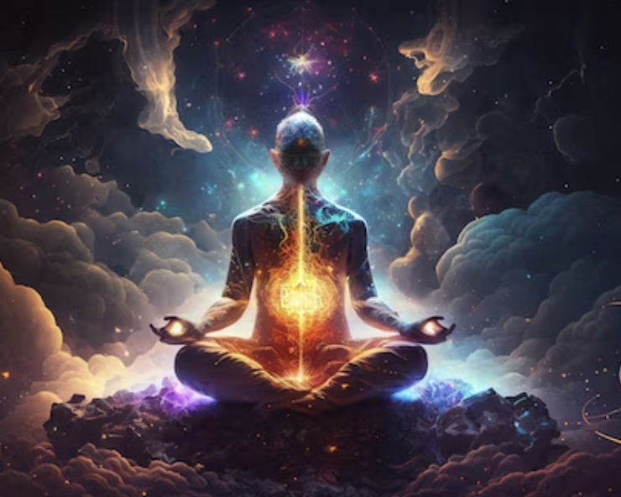
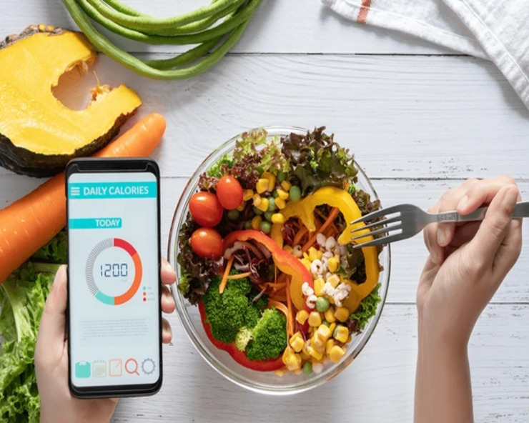
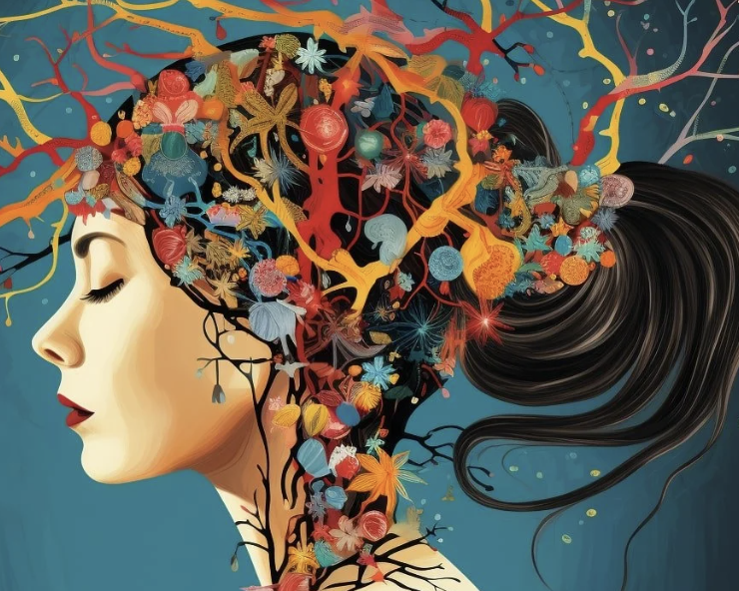
Module Categories
Pose Detector
Pose corrector
Cardio
meditation
Physical health
Mental health

Slide 9

Pose
detector
7 Poses : Tree, Chair, Cobra, Warrior, Dog, Shoulder stand, Triangle.
Accuracy: >95%
Input from Camera
Counts pose time.
Stores correct pose time
Shows best score.
Pretrained Tensorflow JS technology, Posenet

Slide 10
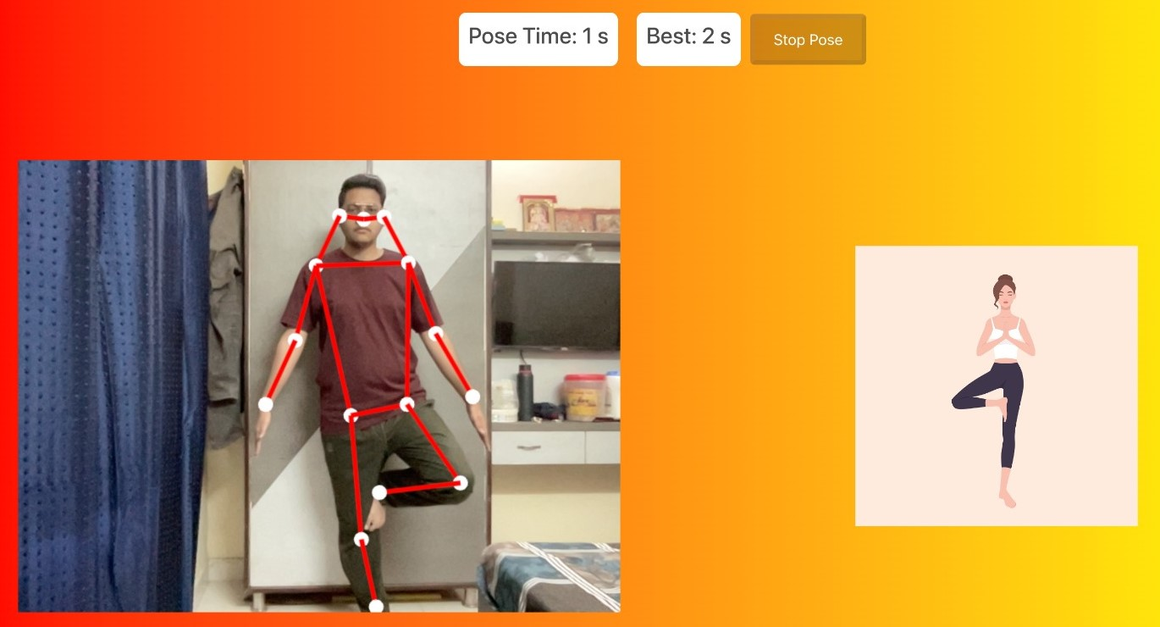
Pose detector
Tree pose
Anomaly because hands are not joined

Slide 11
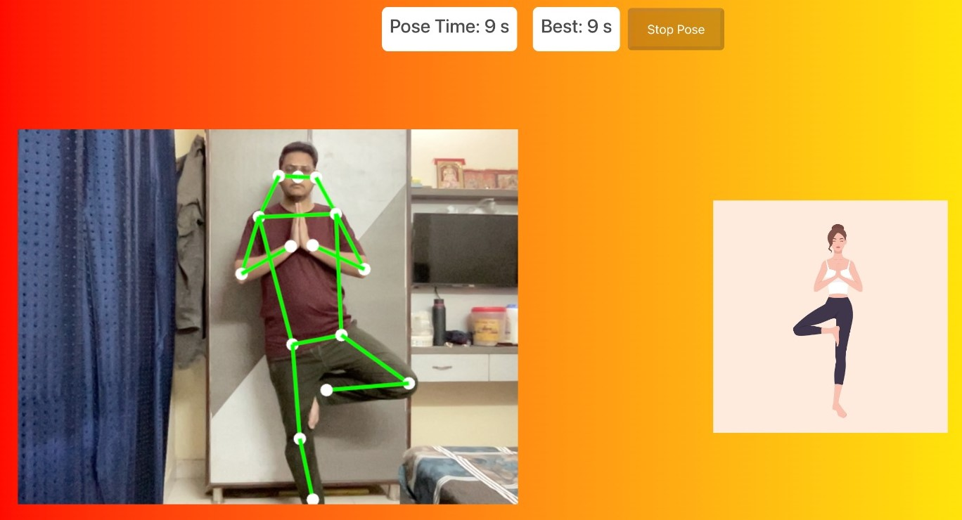
Pose detector
Tree pose
Perfect pose

Slide 12
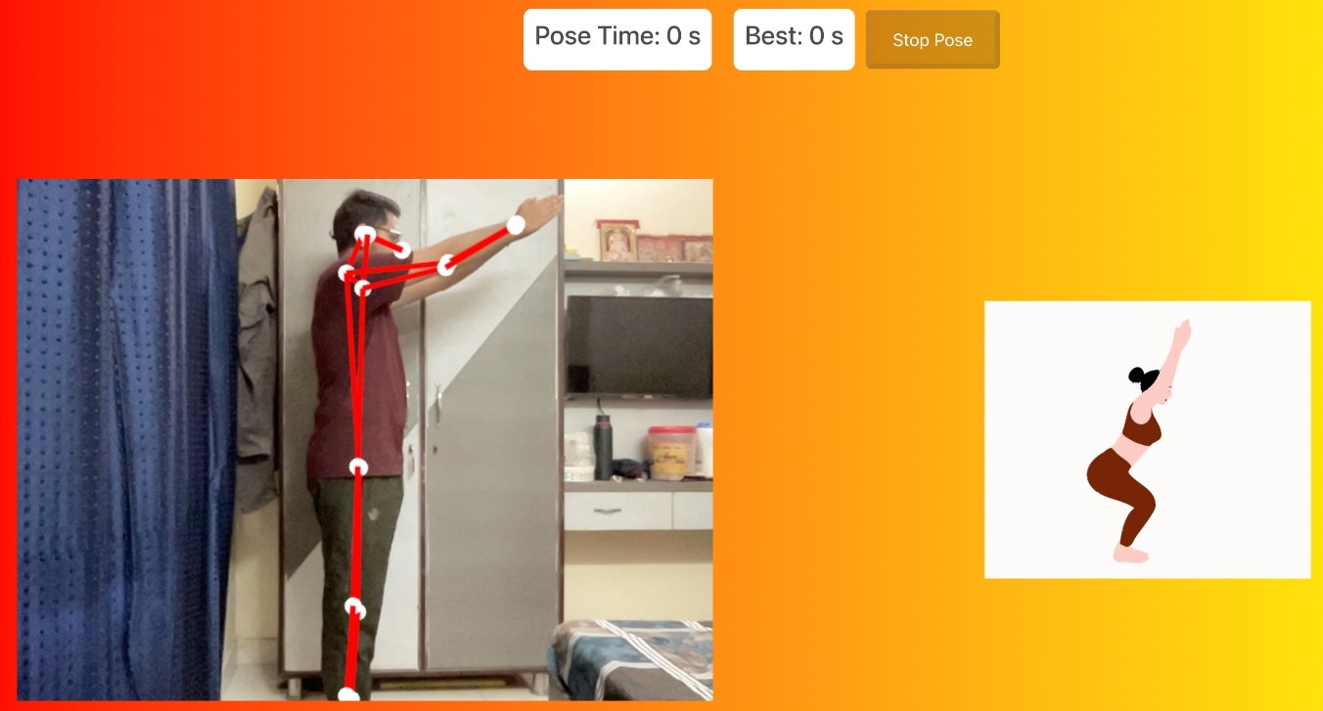
Pose detector
Chair Pose
Anomaly because hip joint is not in proper angle

Slide 13
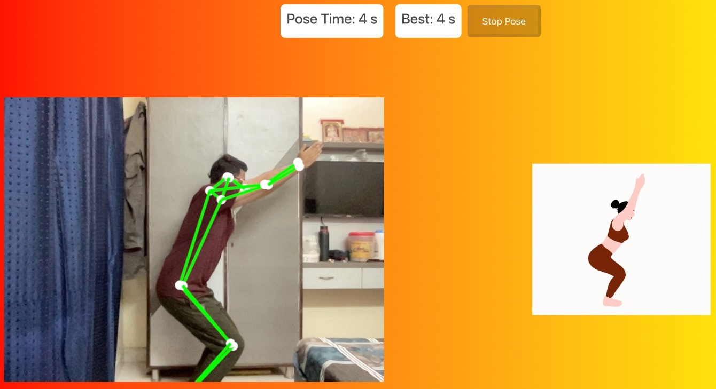
Pose detector
Chair Pose
Perfect pose

Slide 14
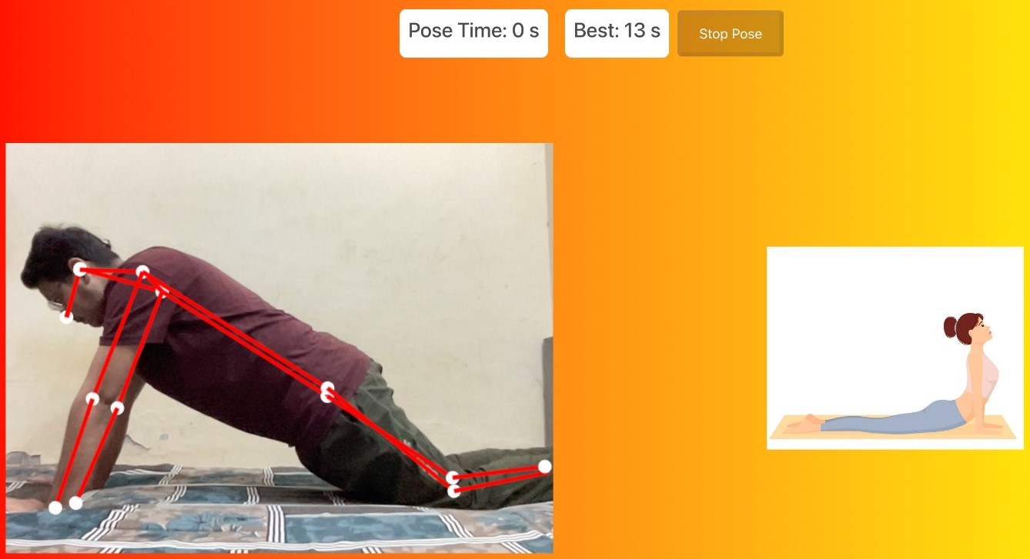
Pose detector
cobra pose
Anomaly because waist is not properly streached

Slide 15
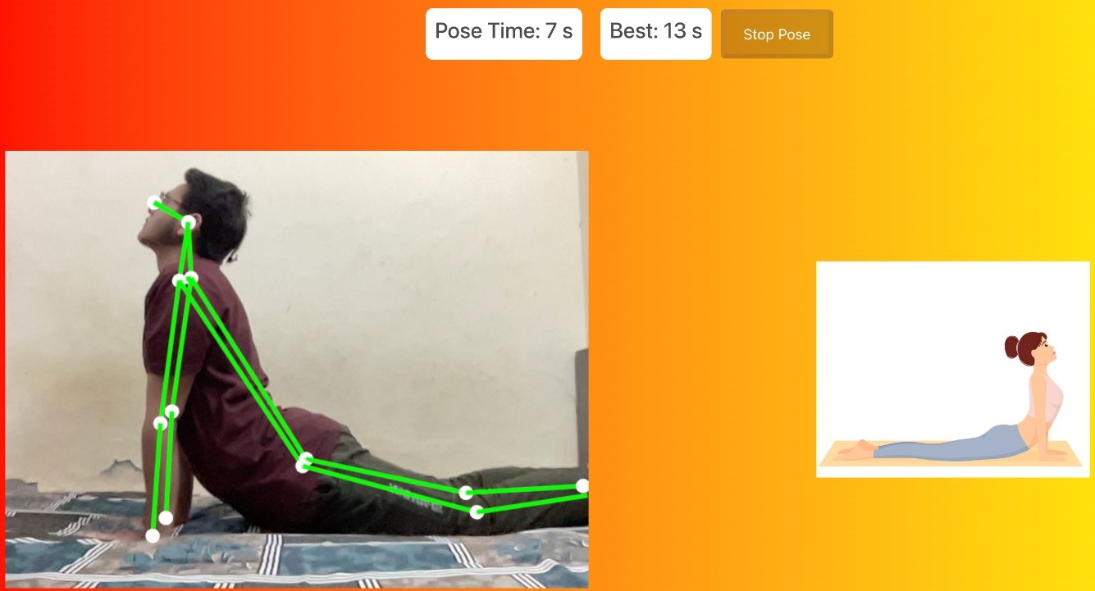
Pose detector
cobra pose
Perfect pose

Slide 16
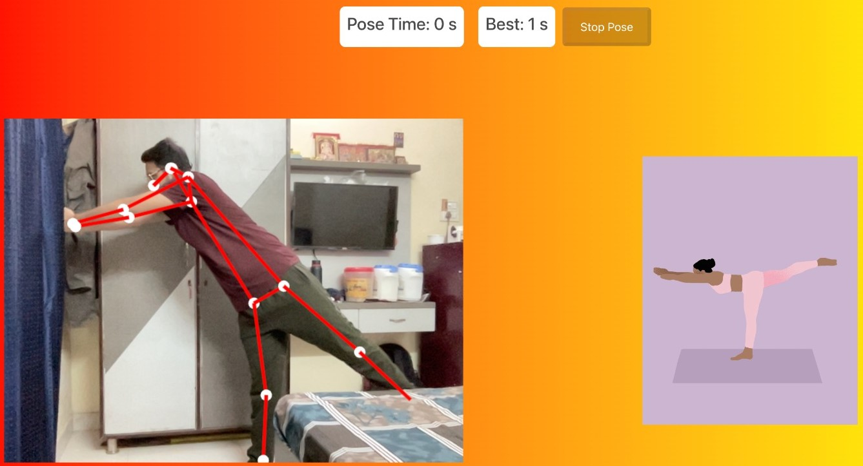
Pose detector
Warrior pose
Anomaly because legs are not high enough

Slide 17
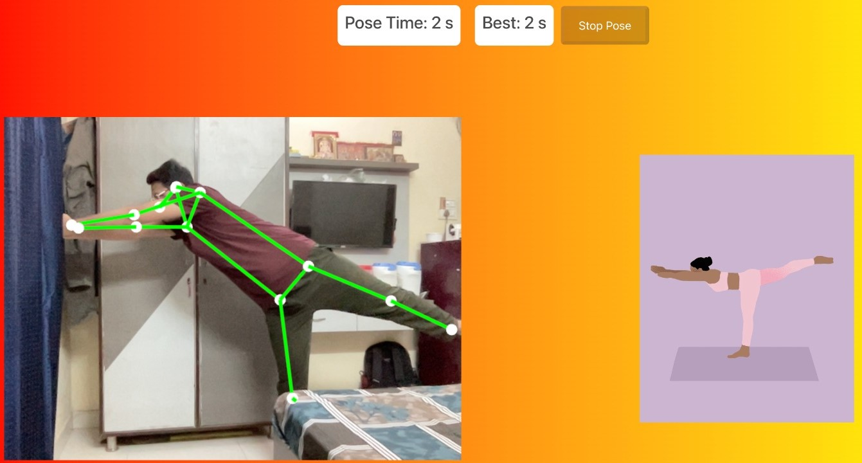
Pose detector
Warrior pose
Perfect pose

Slide 18
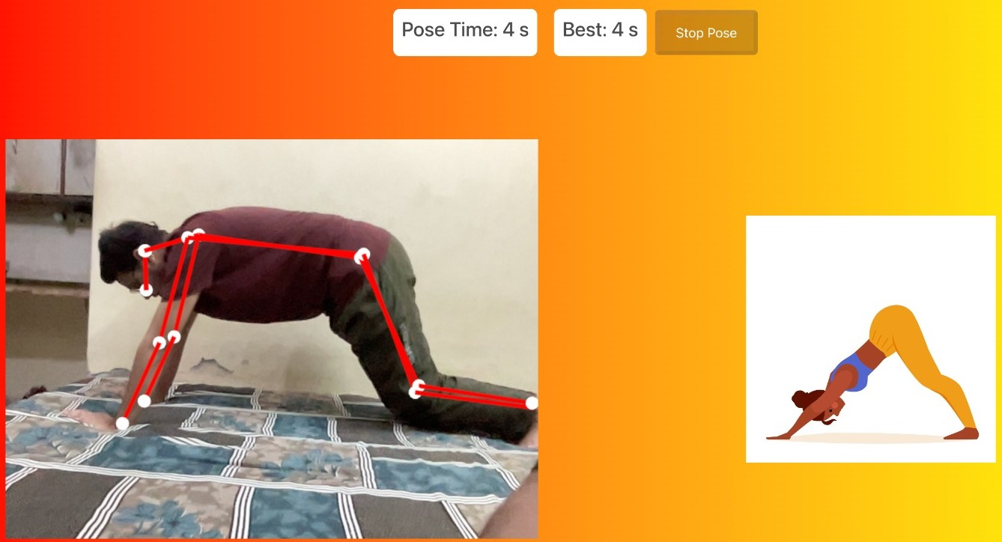
Pose detector
Dog pose
Anomaly because legs are not straight and streached

Slide 19
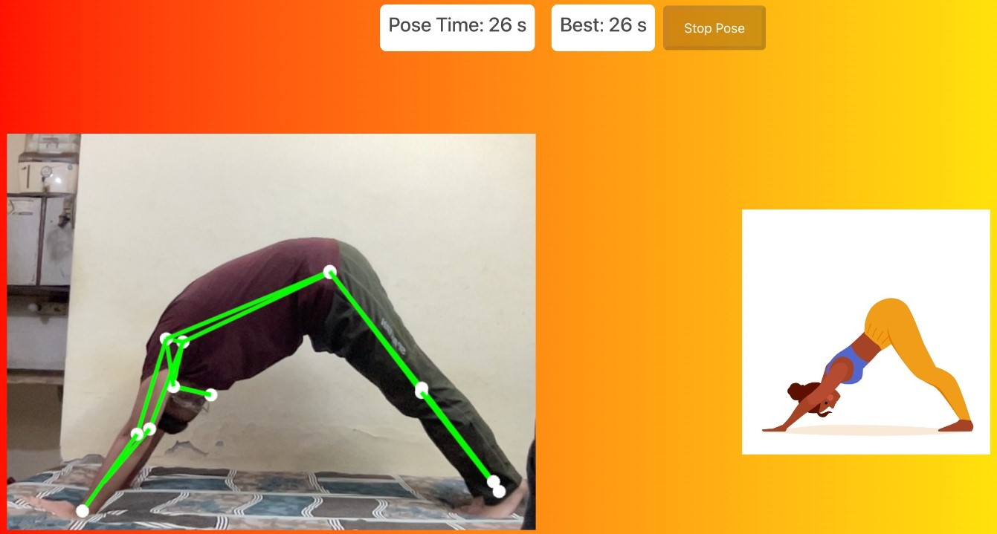
Pose detector
Dog pose
Perfect pose

Slide 20
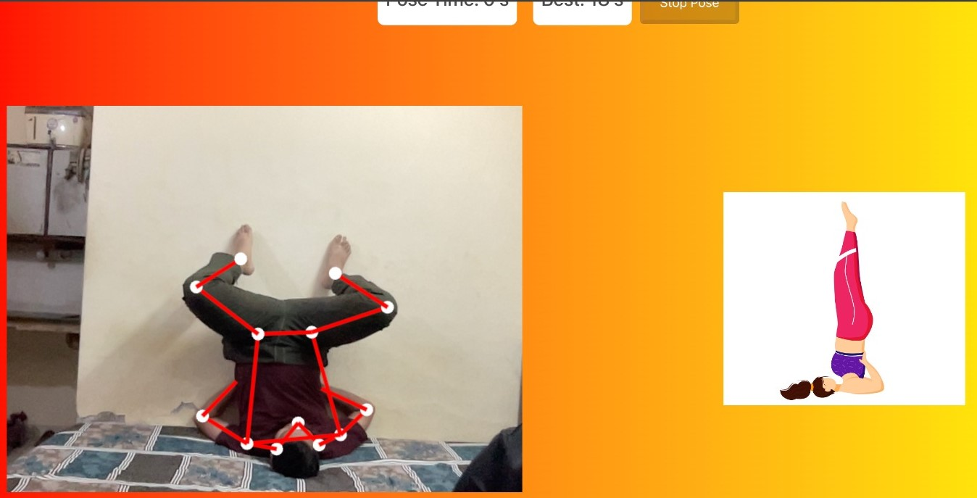
Pose detector
Shoulder stand
Anomaly because legs are not in proper upright position

Slide 21
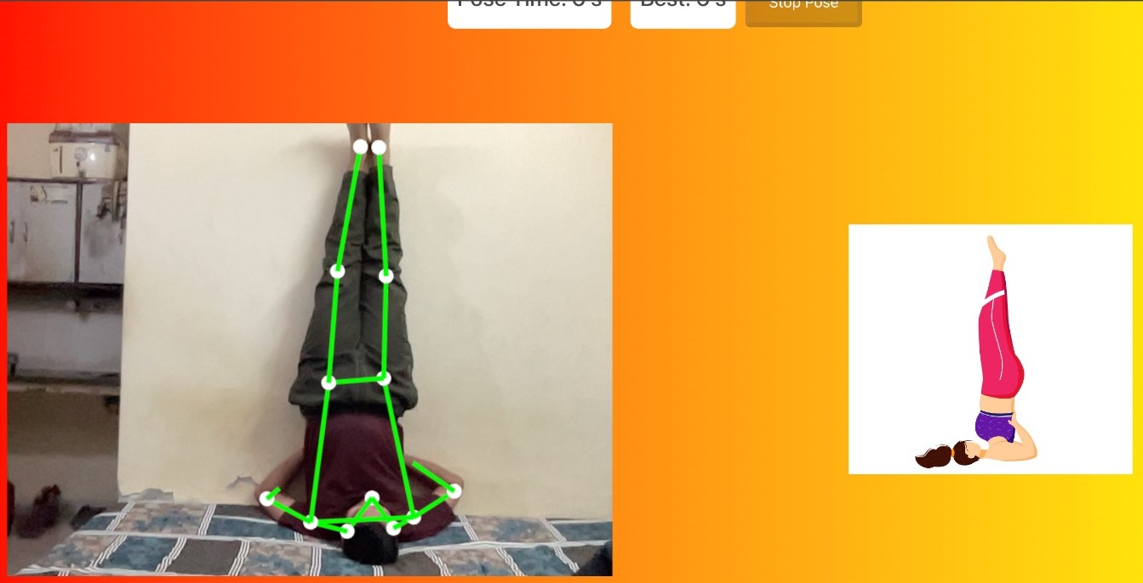
Pose detector
Shoulder stand
Perfect pose

Slide 22
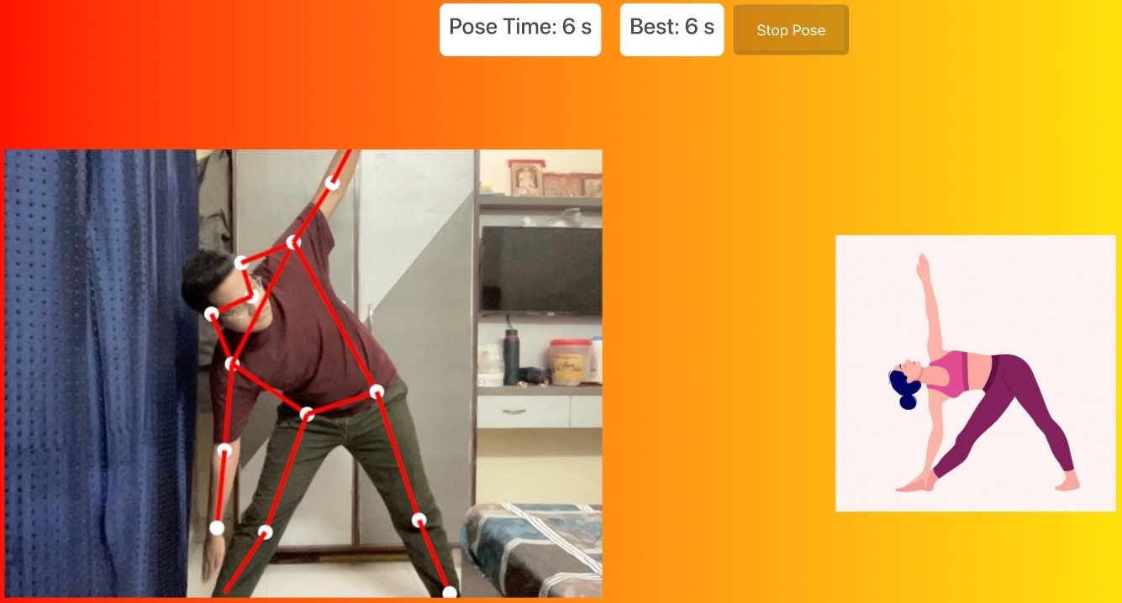
Pose detector
triangle pose
Anomaly because body is not properly bent

Slide 23
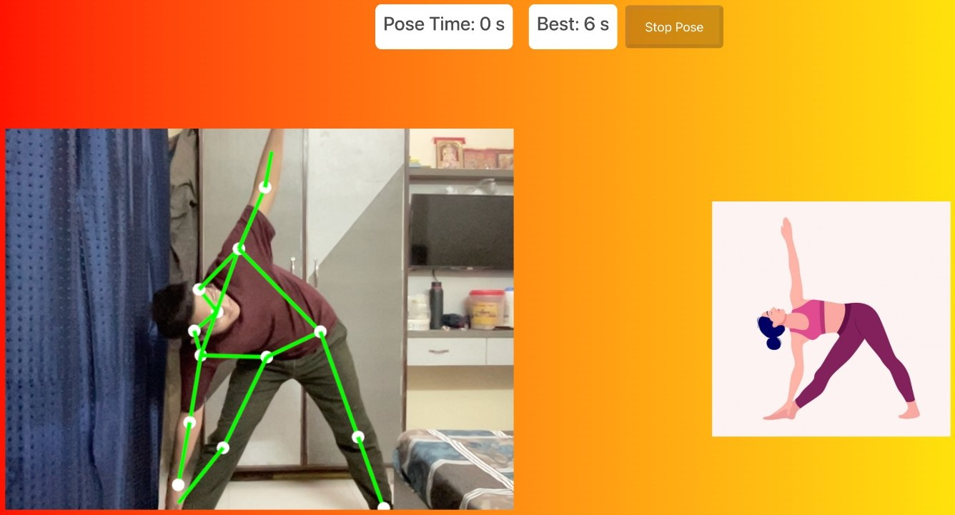
Pose detector
triangle pose
Perfect pose

Slide 24
Pose
corrector
4 Poses: Mountain, Goddess, Garland, Plank
Average accuracy: 77%
Takes input from camera
Gives voice output
Algorithms: PoseNet and K-Nearest Neighbors (KNN) algorithm

Slide 25
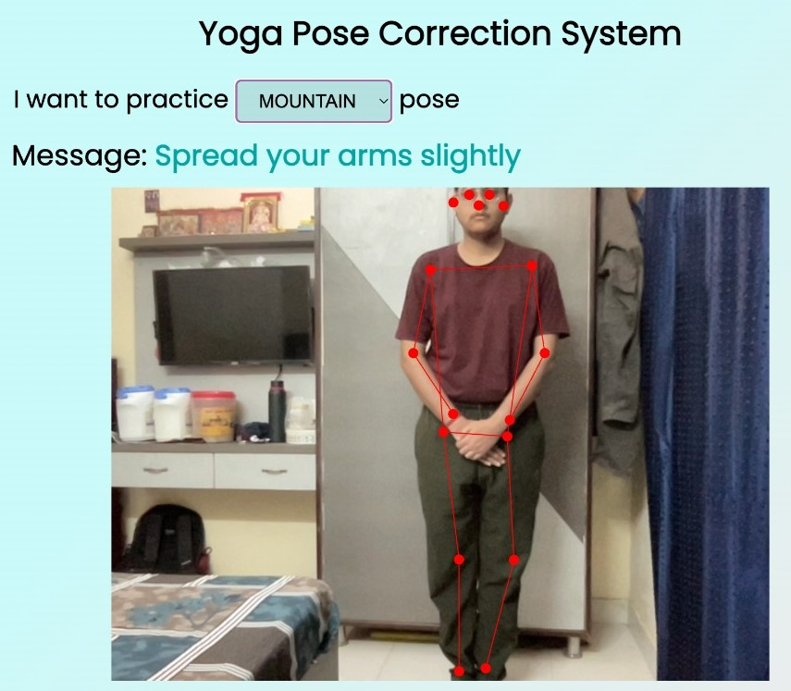
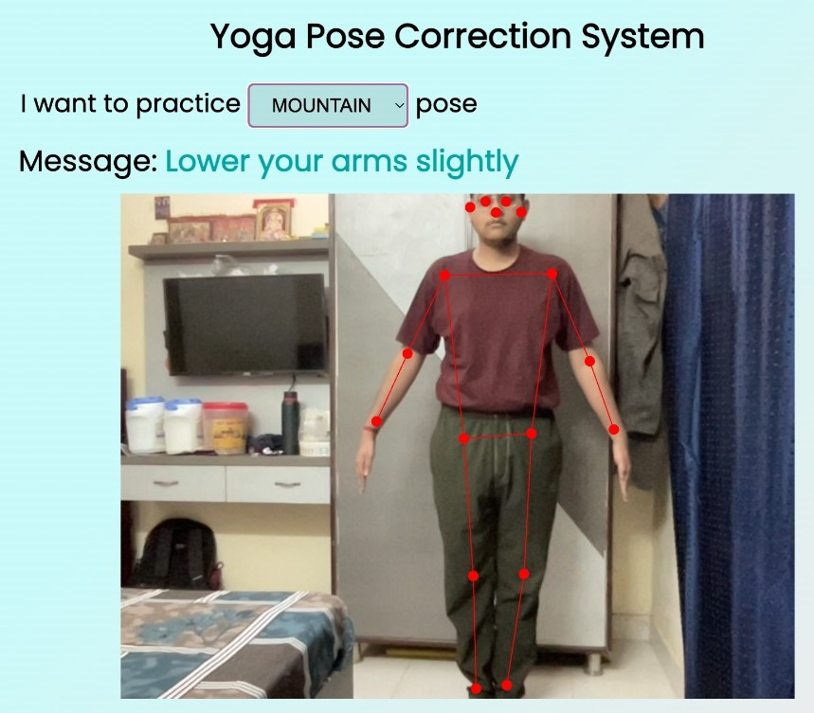
pose corrector
Mountain pose

Slide 26
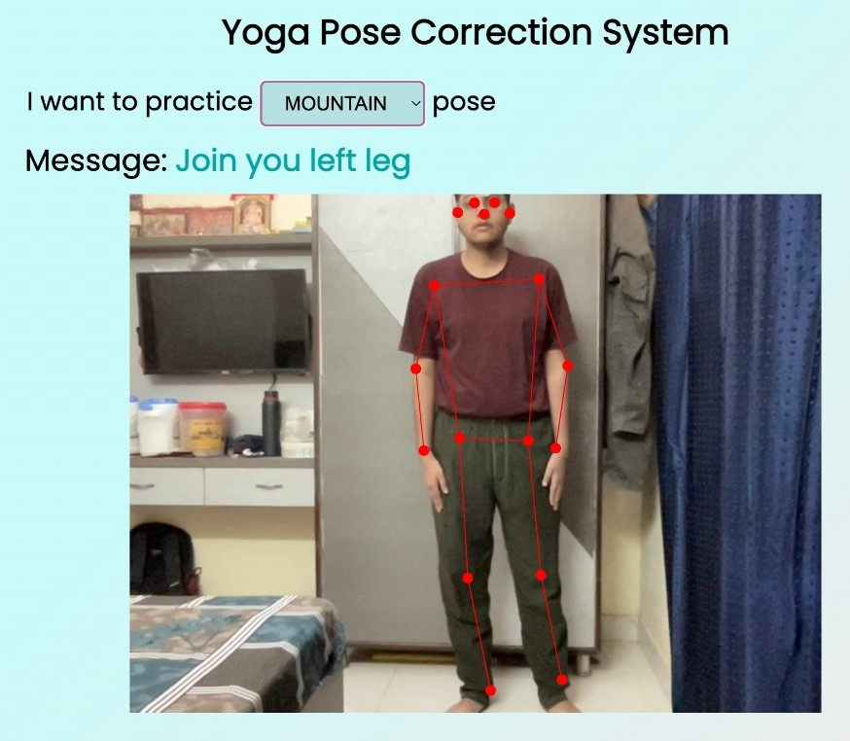

Pose corrector
Mountain pose

Slide 27
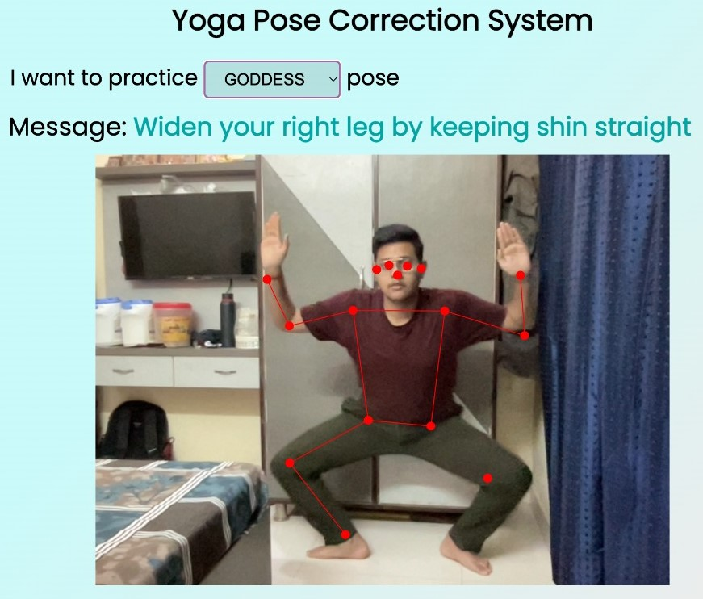
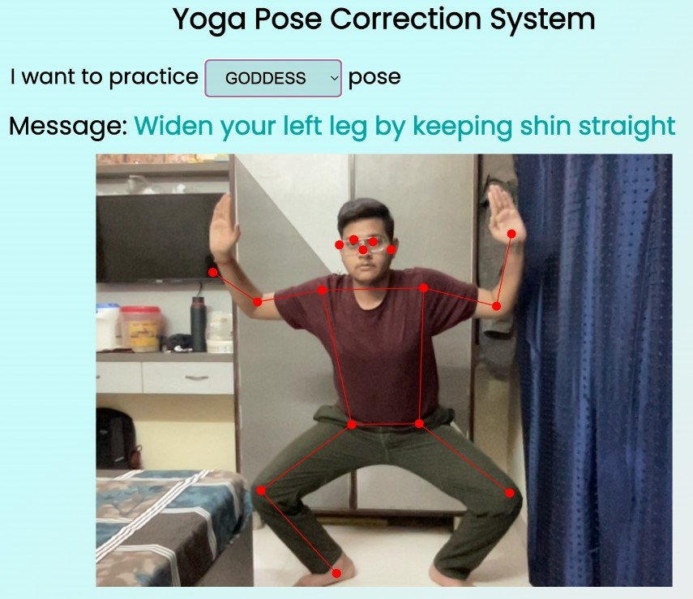
Pose corrector
Garland

Slide 28
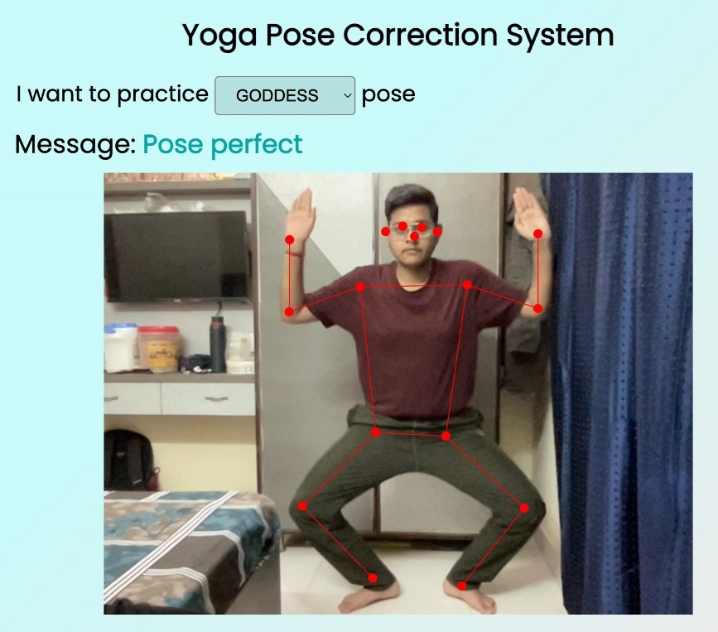
Pose corrector
Garland

Slide 29
pose corrector
goddess

Slide 30
pose corrector
goddess

Slide 31
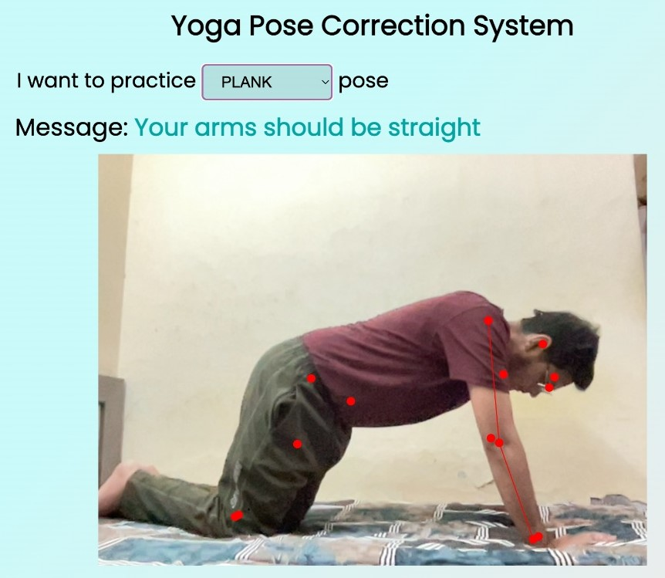
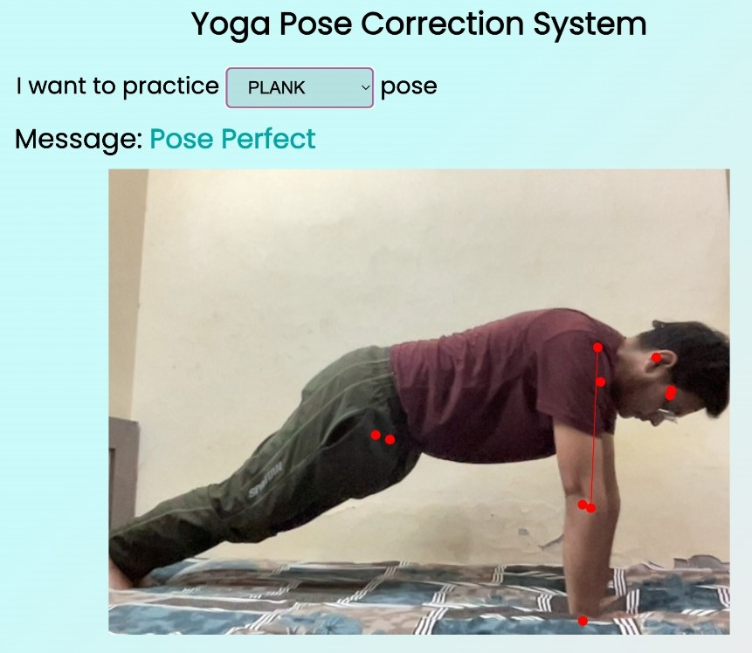
pose corrector
plank

Slide 32
cardio
workout
8 Poses: Squats Counter, Boxing Challenge, Push-ups, Pull- Ups, Skipping, Shoulder Press, Lateral Raises, Jumping jacks.
Average Accuracy: 82%
Takes input from camera
Counts Repetition
Algorithm: MediaPipe Pose detection
Additionally, you can also download app in android phone
Push ups and squat counter
Uses Tensorflow lite and K-means algorithm

Slide 33
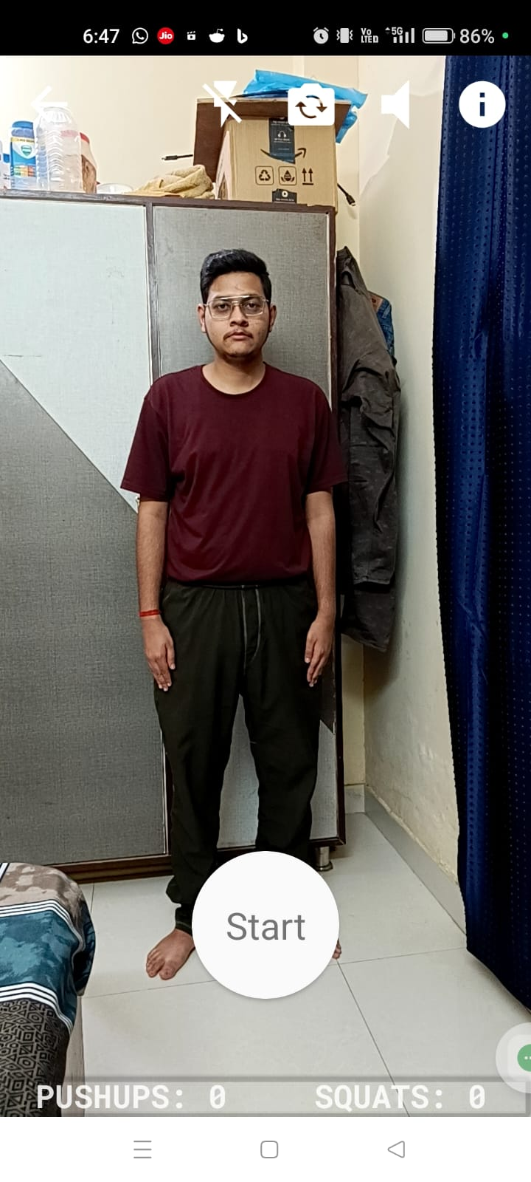
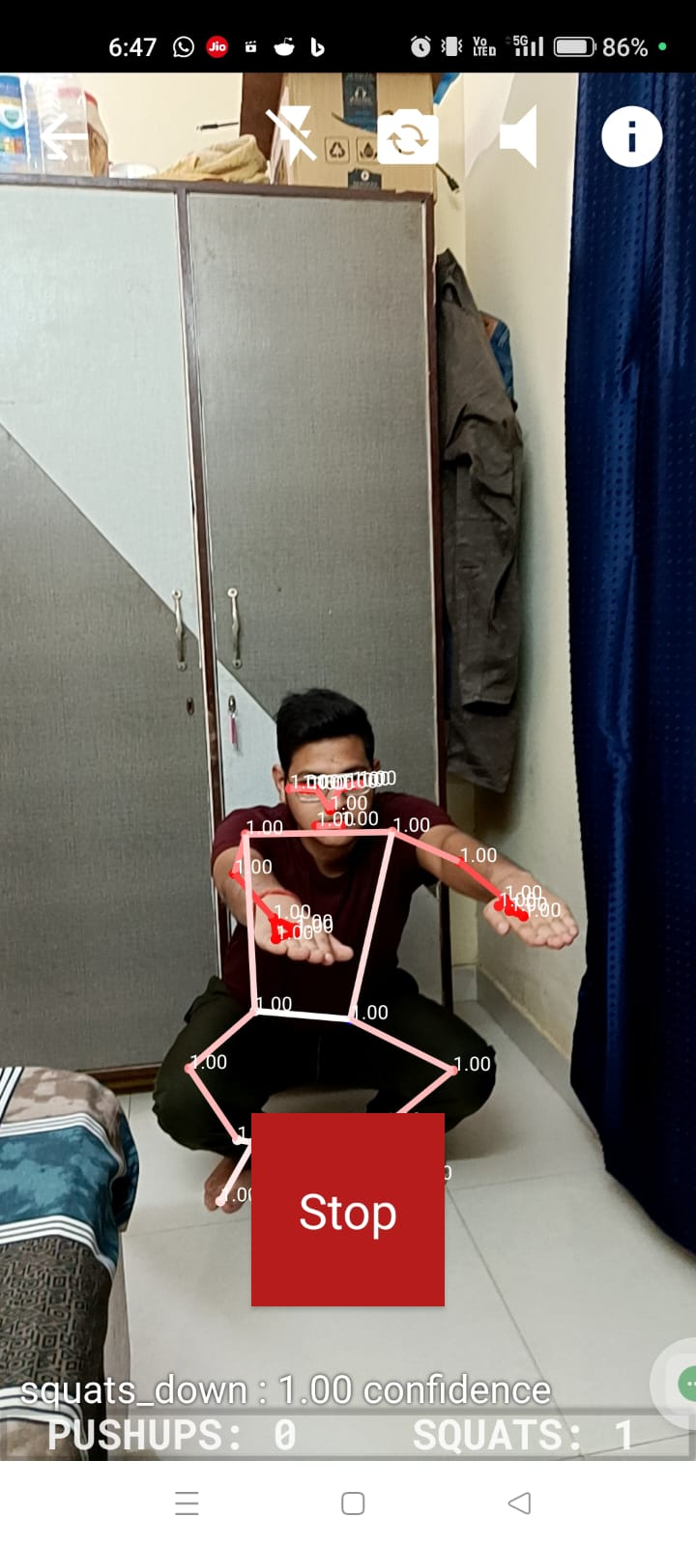
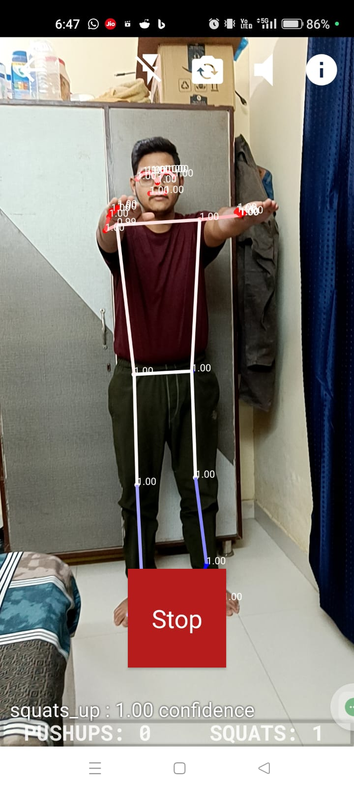
Mobile application
squat counter

Slide 34
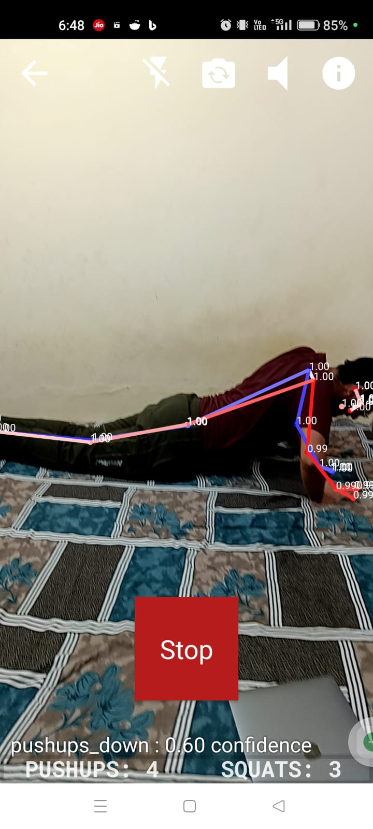
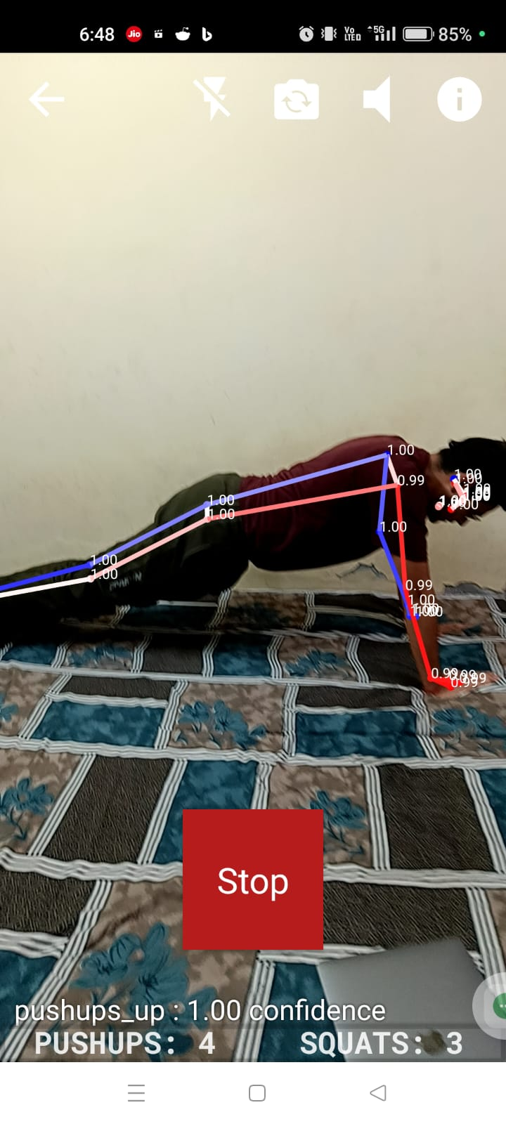
Mobile application
pushups counter

Slide 35
meditation
Takes input form camera
Monitors if user is sitting straight
You can give timer in minutes(by default, 30 mins)
Compares difference between previous and current frame and show the difference on screen
Accuracy: 92%
Custom Image Processing and Computer Vision Algorithms

Slide 36
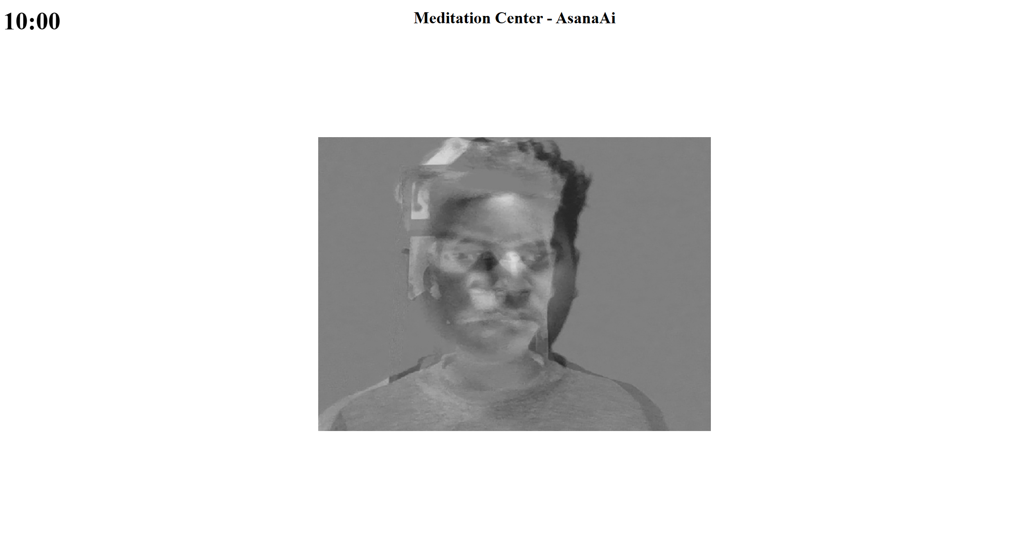
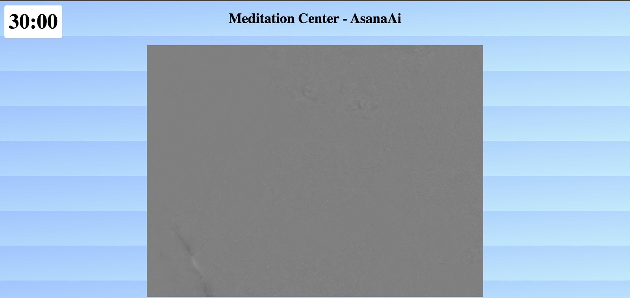
meditation

Slide 37
physical
health
Contains two module
BMI Calculator
Calorie Counter
BMI Calculator
takes input of age in years, height in centimetres and weight in Kgs via text field
Shows if user is underweight, healthy, overweight, obese or extremely obese
Calorie Counter
Takes input of food itesm in text field and tells that how much calorie it has
You can also see what you need to do to burn those calories

Slide 38

physical
health

Slide 39
mental
health
Takes input in form of a questionnaire.
24 questions
Gives graphical result of probable mental condition with percentage of maximum possible score

Slide 40

mental
health

Slide 41
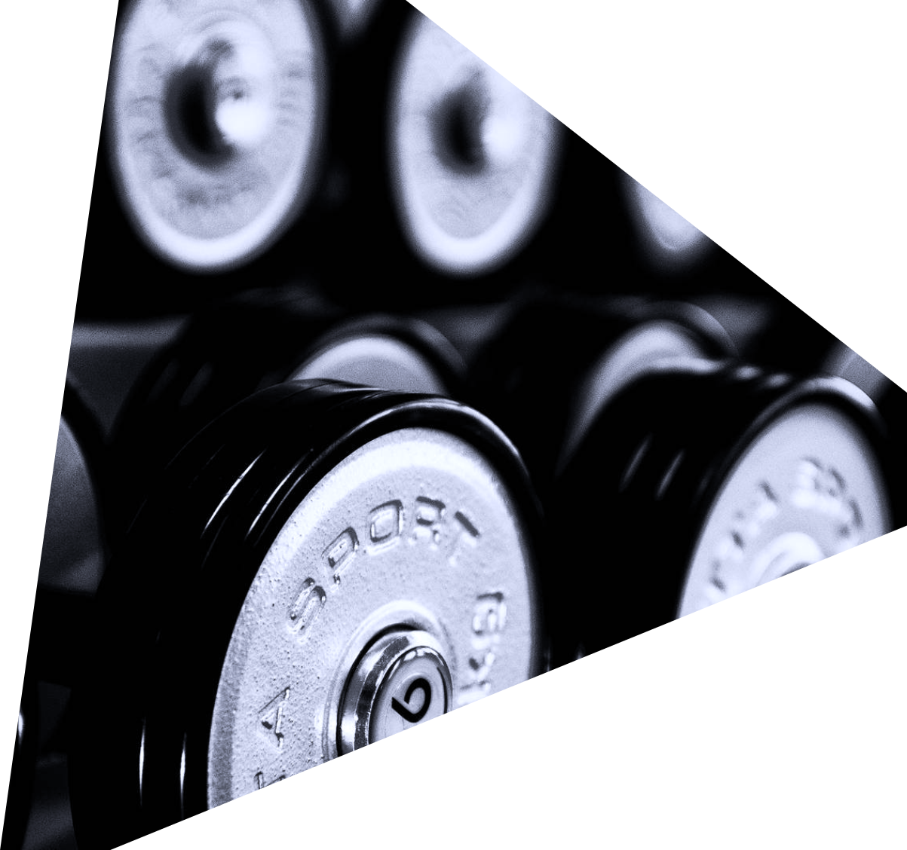
THANK YOU
THANK
YOU
THANK
YOU
THANK
YOU
THANK
Akash Tripathi
Ayush singh
Isha Bhardwaj
Sweta Mishra
Turwash chakraborty

